Slide 1

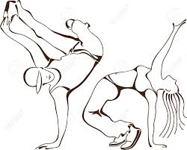


Dance and Fair/Fare
for Bread & Roses
Community Fund
at
Germantown Life Enrichment Center
Saturday April 30
7 – 10 PM
Meet volunteers, visionaries and vendors
and DANCE
$10, Children Free
5722 Greene St., Free Parking
For info, call 215-438-6106

